Slide 1


Digital systems
Chapter 3
Combinational Circuits
Dr. Iness NEDJI MILAT (Lecturer)
iness.nedji@ensia.edu.dz
Pr. Nasreddine LAGRAA
First year – 2023/2024
Nasredine,lagraa@ensia.edu.dz

Slide 2
Combinational Logic Circuit (CLC)
Output of CLC depends only on the combination of its inputs
Combinational logic circuits have no feedback
Combinational
Circuit
n inputs
m outputs
•
•
•
•
•
•

Slide 3
Combinational Logic Circuits
Common combinational circuits made up from logic gates, are basically divided into 3 classes :
Arithmetic and Logical circuits
  Full and Half Adders, Multipliers, Comparator, …
Code converters circuits
  Binary, Gray, BCD code converters
Data transmission circuits
  Multiplexers, Demultiplexers, Encoders, Decoders,

Slide 4
Half and Full Adders

Slide 5
Functional Block: Half-Adder
Half adder is a CLC which has two single bit inputs and two single bit outputs. It performs the following computations:
A half adder adds two bits to produce a two-bit sum
The sum is expressed as
  a sum bit , S and a carry bit, C
The half adder can be specified as a truth table for S and C ⇒
A
0
0
1
1
A
Half adder
S
+ B
+ 0
+ 1
+ 0
+ 1
B
C
C S
0 0
0 1
0 1
1 0
A | B | S | C
0 | 0 | 0 | 0
0 | 1 | 1 | 0
1 | 0 | 1 | 0
1 | 1 | 0 | 1

Slide 6




Logic Simplification: Half-Adder
 |  | 0 | 1
0 |  | 0 | 1
1 |  | 1 | 0
The K-Map for S is:
The K-Map for C is:
These equations lead to the following implementation.
$$B$$
$$A$$

S
=
A
·
B
+
A
·
B
=
A
⊕
B
 |  | 0 | 1
0 |  | 0 | 0
1 |  | 0 | 1
$$B$$
$$A$$

C
=
A
·
B
A
S
B
C

Slide 7
Functional Block: Full-Adder
R
A full adder is similar to a half adder, but includes a carry-in bit from lower stages. It has Three single bit inputs and two single bit outputs.
Like the half-adder, it computes a sum bit, S and a carry bit, C.
  For a carry-in (R) of 0,
  it is the same as the half-adder:
  For a carry- in (R) of 1:
A
Full adder
S
B
C
R
0
0
0
0
A
0
0
1
1
+ B
+ 0
+ 1
+ 0
+ 1
C S
0
0
0 1
0 1
1 0
R
1
1
1
1
A
0
0
1
1
+ B
+ 0
+ 1
+ 0
+ 1
C S
0 1
1 0
1 0
1
1

Slide 8




Logic Simplification: Full-Adder
Full-Adder K-Map:
Full-Adder Equations :
Full-Adder Truth Table
A | B | R | S | C
0 | 0 | 0 | 0 | 0
0 | 0 | 1 | 1 | 0
0 | 1 | 0 | 1 | 0
0 | 1 | 1 | 0 | 1
1 | 0 | 0 | 1 | 0
1 | 0 | 1 | 0 | 1
1 | 1 | 0 | 0 | 1
1 | 1 | 1 | 1 | 1
 |  | 00 | 01 | 11 | 10
0 |  | 0 | 1 | 0 | 1
1 |  | 1 | 0 | 1 | 0
K-map for S
$$BR$$
$$A$$
S
=
A 
B 
R
+
A 
B 
R
+
A 
B 
R
+
A 
B 
R

S
=
A
⊕
B
⊕
R
 |  | 00 | 01 | 11 | 10
0 |  | 0 | 0 | 1 | 0
1 |  | 0 | 1 | 1 | 1
K-map for C
C
=
A 
B
+
A 
R
+
B 
R
$$BR$$
$$A$$
=
+
A 
B 
+
A
R
+
C
A 
B
R
R
·
B 
A 
B 
R

C = R (A.B + A.B) + A.B (R + R)
C
=
A 
B
+
(
A
⊕
B
)
· R
·

Slide 9

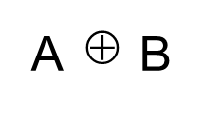


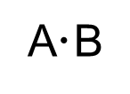

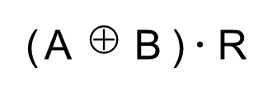



A
B
Logic diagram of full adder
S
=
A
⊕
B
⊕
R
R
C
=
A
B
+
(
A
⊕
B
)
· R
C
S
Half adder
Half adder

Slide 10
Implementation of adders
1
1
0
1 1 1 1
Imitate Adding by Hand
  One column at a time
    Compute sum, add carry to next column
Create component for each column
  Four bits  Fours adders
  1 half adder
  and 3 full adders
+ 0 1 1 0
1
0
1
0
1
1
1
0
0
1
1
1
1
1
0
1
b
a
ci
b
a
ci
b
a
ci
b
a
c
o
s
c
o
s
c
o
s
c
o
s
1
0
1
0
1
Full-adders
Half-adder

Slide 11
Carry-Ripple Adder
Using half-adder and full-adders, we can build adder that adds like we would by hand
Called a carry-ripple adder
  4-bit adder shown: Adds two 4-bit numbers, generates 5-bit output
    5-bit output can be considered 4-bit “sum” plus 1-bit “carry out”
  Can easily build any size adder
a3
b3
a2
b2
a1
b1
a0
b0
a
b
ci
a
b
ci
a
b
ci
a
b
a3
a2
a1
a0
b3
b2
b1
b0
F
A
F
A
F
A
HA
4-bit adder
c
o
s
c
o
s
c
o
s
c
o
s
c
o
s3
s2
s1
s0
c
o
s3
s2
s1
s0
(
a
)
(
b
)

Slide 12
Carry-Ripple Adder
Using full-adder instead of half-adder for first bit, we can include a “carry in” bit in the addition
  Will be useful later when we connect smaller adders to form bigger adders
a3
b3
a2
b2
a1
b1
a0
b0
ci
a
b
ci
a
b
ci
a
b
ci
a
b
ci
a3
a2
a1
a0
b3
b2
b1
b0
F
A
F
A
F
A
F
A
4-bit adder
ci
c
o
s
c
o
s
c
o
s
c
o
s
c
o
s3
s2
s1
s0
c
o
s3
s2
s1
s0
(
a
)
(
b
)

Slide 13
Magnitude Comparator

Slide 14



One-bit Comparator
$$A$$
$$B$$
0
$$Gt$$
Eq
Lt
AB'
(A>B)
Gt
0 0 0 1 0
0 1 0 0 1
1 0 1 0 0
1 1 0 1 0
Gt =
A
1bit
comp
A'B'+ AB = A xnor B
(A=B)
Eq
Eq =
B
Lt
Lt =
A'B
(A<B)
Gt
A
B
Eq
Lt

Slide 15
Magnitude comparator
N-bit magnitude comparator
  Indicates whether A>B, A=B, or A<B, for its two N-bit inputs A and B
  How design?
    Consider how compare by hand.
    First compare a3 and b3.
    If equal, compare a2 and b2.
    And so on…
    Stop if comparison not equal :
      whichever’s bit is 1 is greater.
      If never see unequal bit pair, A=B.
  Example: compare A and B
A=1011
B=1001
1011
1001
Equal
1011
1001
Equal
1011
1001
Unequal
So A > B

Slide 16
Magnitude comparator
By-hand example leads to idea for design
  Start at left, compare each bit pair (MSB), pass results to the right
  Each bit pair called a stage
  Each stage has 3 inputs indicating results of higher stage, passes results to lower stage
a3
b3
a2
b2
a1
b1
a0
b0
a
b
a
b
a
b
a
b
Igt
in_gt
out_gt
in_gt
out_gt
in_gt
out_gt
in_gt
out_gt
AgtB
Ieq
in_eq
out_eq
in_eq
out_eq
in_eq
out_eq
in_eq
out_eq
AeqB
Ilt
in_lt
out_lt
in_lt
out_lt
in_lt
out_lt
in_lt
out_lt
AltB
Stage 3
Stage 2
Stage 1
Stage 0
0
Igt
a3
a2
a1
a0
b3
b2
b1
b0
AgtB
1
Ieq
4-bit magnitude comparator
AeqB
0
Ilt
AltB

Slide 17
Magnitude comparator
a3
b3
a2
b2
a1
b1
a0
b0
a
b
a
b
a
b
a
b
Igt
in_gt
out_gt
in_gt
out_gt
in_gt
out_gt
in_gt
out_gt
AgtB
Ieq
in_eq
out_eq
in_eq
out_eq
in_eq
out_eq
in_eq
out_eq
AeqB
Ilt
in_lt
out_lt
in_lt
out_lt
in_lt
out_lt
in_lt
out_lt
AltB
Stage 3
Stage 2
Stage 1
Stage 0
Each stage:
  out_gt = in_gt + (in_eq . a . b )
    A>B (so far) if already determined in higher stage,
    or if higher stages equal but in this stage a=1 and b=0
  out_lt = in_lt + (in_eq . a . b)
    A<B (so far) if already determined in higher stage,
    or if higher stages equal but in this stage a=0 and b=1
  out_eq = in_eq . (a XNOR b)
    A=B (so far) if already determined in higher stage and in this stage a=b too

Slide 18

Magnitude comparator : Example
Compare 1011 and 1001
a3
b3
a2
b2
a1
b1
a0
b0
1
1
0
0
1
0
1
1
a
b
a
b
a
b
a
b
0
0
1
1
Igt
in_gt
out_gt
1
in_gt
out_gt
1
in_gt
out_gt
0
in_gt
out_gt
0
AgtB
Ieq
in_eq
out_eq
0
in_eq
out_eq
0
in_eq
out_eq
0
in_eq
out_eq
0
AeqB
Ilt
in_lt
out_lt
in_lt
out_lt
in_lt
out_lt
in_lt
out_lt
AltB
Stage 3
Stage 2
Stage 1
Stage 0
Final answer appears on the right
Takes time for answer to “ripple” from left to right

Slide 19
Decoder

Slide 20


Decoders
A decoder is a CLC that has n inputs representing a binary number (Code of information) and 2^{n} outputs representing information.
It activates only one output that corresponds to
that input number. all other outputs remain inactive.
It extracts “Information” from the code.
Example: 2 to 4 Decoder (1/4)
)
I_{n}
O₀
Decoder
n x 2^{n}
(1/2^{n})
I₀
O_{m}
n inputs
2^{n} outputs
Only one lamp (Inf) will turn on
0
1
1
0
Decoder
2 x 4
(1/4)
0
0
0
1
0
0
1
1
0
1
0
0
1
0
0
0
0
0
1
0
x₁
x₀

Slide 21
Decoders
29
2 to 4 Line Decoder
O₃
I₁ | I₀ | O₃ | O₂ | O₁ | O₀
0 | 0 | 0 | 0 | 0 | 1
0 | 1 | 0 | 0 | 1 | 0
1 | 0 | 0 | 1 | 0 | 0
1 | 1 | 1 | 0 | 0 | 0
O₂
O₃
I₁
O₂

O₁
Decoder 2x4

I₀
O₁
O₀
O₀
I₁
I₀

Slide 22
Decoders
The decoder is useful in determining how to interpret a bit pattern
It could be the address of a row in DRAM, that the processor intends to read from
It could be an instruction in the program and the processor needs to decide what action to take (based on instruction opcode)
O₃
O₂
O₁
O₀
I₁
I₀

Slide 23
Decoders
3-to-8 Line Decoder (1/8 Decoder)
  Binary-to-Octal Encoder (3-to-8)
O₇
O₆
O₅
O₇
O₄
O₆
I₂
O₅
O₃
I₁
O₄

I₀
Decoder 3x8
O₂
O₃
O₂
O₁
O₁
O₀
O₀
I₂
I₁
I₀

Slide 24
Decoders
Expansion
E
O₇
I₁
O₆
Decoder 2x4
O₅
I₂ | I₁ | I₀ | o₀ | o₁ | o₂ | o₃ | o₄ | o₅ | o₆ | o₇
0 | 0 | 0 | 1 | 0 | 0 | 0 | 0 | 0 | 0 | 0
0 | 0 | 1 | 0 | 1 | 0 | 0 | 0 | 0 | 0 | 0
0 | 1 | 0 | 0 | 0 | 1 | 0 | 0 | 0 | 0 | 0
0 | 1 | 1 | 0 | 0 | 0 | 1 | 0 | 0 | 0 | 0
1 | 0 | 0 | 0 | 0 | 0 | 0 | 1 | 0 | 0 | 0
1 | 0 | 1 | 0 | 0 | 0 | 0 | 0 | 1 | 0 | 0
1 | 1 | 0 | 0 | 0 | 0 | 0 | 0 | 0 | 1 | 0
1 | 1 | 1 | 0 | 0 | 0 | 0 | 0 | 0 | 0 | 1
I₀
O₄
E
O₃
I₁
O₂
Decoder 2x4
I₀
O₁
O₀
I₂
I₁
I₀

Slide 25
Encoders

Slide 26
Encoders
An encoder performs the inverse operation of a decoder.
It has 2^{n} inputs (information), and n outputs (Code of information).
Only one input can be logic 1 at any given time (active input). All other inputs must be 0’s.
Output lines generate the binary code corresponding to the active input.
2^{n} Inputs
2^{n} to n
Encoder
Binary code of active input
n Outputs

Slide 27
Encoders
Only one switch should be activated at a time
Put “Information” into code
Binary Encoder
  Example: 4-to-2 Binary Encoder
x₁
x₂
x₃
Binary
Encoder
x₃ x₂ x₁ | y₁ y₀
0 0 0 | 0 0
0 0 1 | 0 1
0 1 0 | 1 0
1 0 0 | 1 1
y₁
y₀

Slide 28
Encoders
Octal-to-Binary Encoder (8 to 3)
I₇
I₆
I₅
I₄ I₃
I₂
I₁
I₀
I₇ I₆ I₅ I₄ I₃ I₂ I₁ I₀ | Y₂ Y₁ Y₀
0 0 0 0 0 0 0 1 | 0 0 0
0 0 0 0 0 0 1 0 | 0 0 1
0 0 0 0 0 1 0 0 | 0 1 0
0 0 0 0 1 0 0 0 | 0 1 1
0 0 0 1 0 0 0 0 | 1 0 0
0 0 1 0 0 0 0 0 | 1 0 1
0 1 0 0 0 0 0 0 | 1 1 0
1 0 0 0 0 0 0 0 | 1 1 1
I₇
I₆
Y₂
I₅
Binary
Encoder
I₄
Y₂
Y₁
Y₀
I₃
Y₁
I₂
Y₀
I₁
I₀

Slide 29
Multiplexer

Slide 30
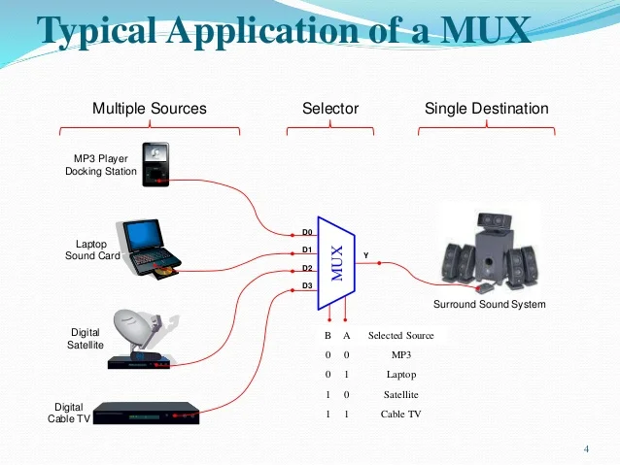
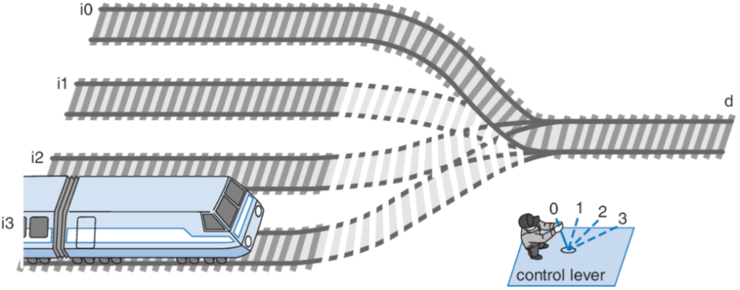
Example

Slide 31
Multiplexer
The multiplexer or data selector , shortened to “MUX” is a logic circuit that accepts several Data inputs and selects one of them at any given time to pass on to the output.
This selection is controlled by Select inputs (often referred to as Control or Address inputs).
  4 input mux → needs 2 select inputs
  to indicate which input to route through,
  8 input mux → 3 select inputs,
  2^{n} inputs → n select inputs
I₀
I₁
Mux
2^{n} x n
O
I_{m}
m = 2^{n}
S_{n}
S₀
MSB
LSB

Slide 32
Mux Internal Design
Mux 2x1
I₀
I₀
Y=I₀
2x1 Mux
1
I₀
y
I₀
y
I₀
I₁
I₁
I₁
I₁
y
0
0
S₀
S₀=0
S₀=1
S₀=0
Mux 4x1
I₃
I₃
S₁ S₀ | Y
0 0 | I₀
0 1 | I₁
1 0 | I₂
1 1 | I₃
I₂
I₂
y
4x2 Mux


y
I₁
I₁
I₀
I₀
S₁
S₀
S₁
S₀

Slide 33
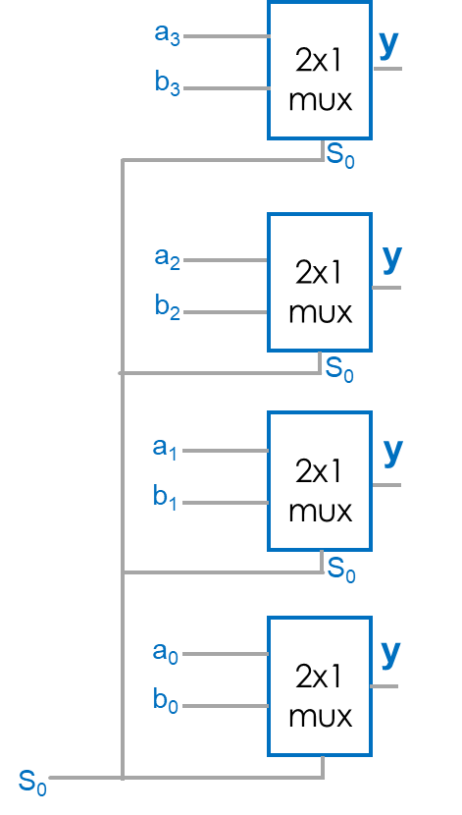
Muxes Commonly Together -- N-bit Mux
45
Ex: Two 4-bit inputs, A (a3 a2 a1 a0), and B (b3 b2 b1 b0)
  4-bit 2x1 mux (just four 2x1 muxes sharing a select line) can select between A or B
4-bit
4
2x1
A
I
0
4
4
D
C
B
I
1
s0
s0

Slide 34
Demultiplexer

Slide 35
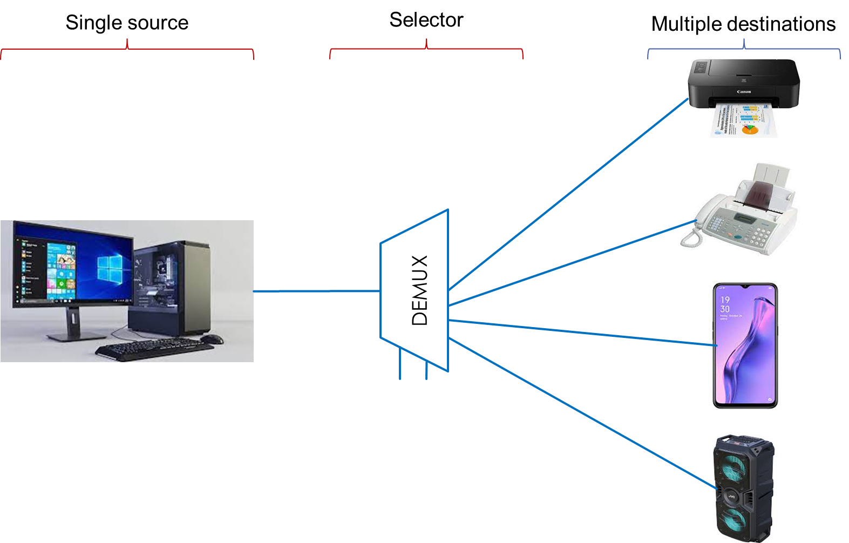
Demultiplexer
S₁ | S₀ | Destination
0 | 0 | Printer
0 | 1 | Fax
1 | 0 | Phone
1 | 1 | Speaker

Slide 36
Demultiplexer
Demultiplexer (Demux) or Data distributors performs the inverse operation of a Mux.
Given an input line and a set of selection lines, the demultiplexer will direct data from input to a selected output line.
D
S₁ | S₀ | O₀ | O₁ | O₂ | O₃
0 | 0 | D | 0 | 0 | 0
0 | 1 | 0 | D | 0 | 0
1 | 0 | 0 | 0 | D | 0
1 | 1 | 0 | 0 | 0 | D
S₁
Data
D
Demux
2 x 4
S₀
O₀
O₁
S₁ S₀
O₂
Data D is transmitted to only one of the outputs as determined by select input code S₁S₀,
O₃

